Slide 1
QCNN- For Image Classification
Using MNIST Fashion Dataset.
-SUMIT(M23IQT007)

Slide 2
Need to know
Quantum computing basics
PennyLane library
TensorFlow and Keras
Convolutional Neural Networks (CNNs)
Matplotlib
To understand and implement QCNNs, you will need a basic understanding of quantum computing, including qubits, gates, and quantum circuits. You will also need to be familiar with the PennyLane library for quantum machine learning, TensorFlow and Keras for classical machine learning, Convolutional Neural Networks (CNNs), and Matplotlib for plotting results.

Slide 3
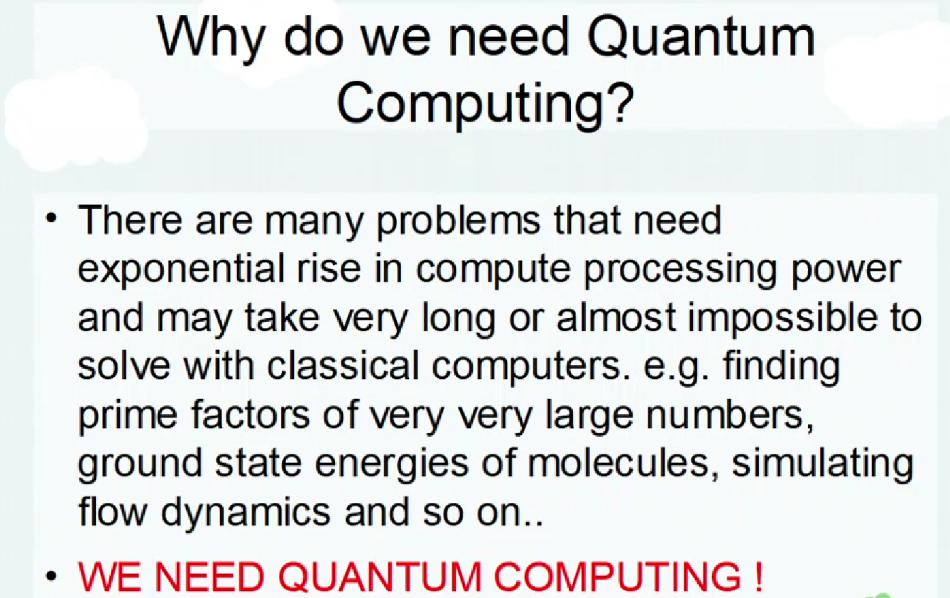
Quantum Convolutional Neural Networks
Quantum Convolutional Neural Networks (QCNNs). Convolutional Neural Networks (CNNs) are a type of neural network that have been very successful in image recognition tasks. QCNNs are a new type of CNN that uses quantum mechanics to improve the performance of CNNs.

Slide 4
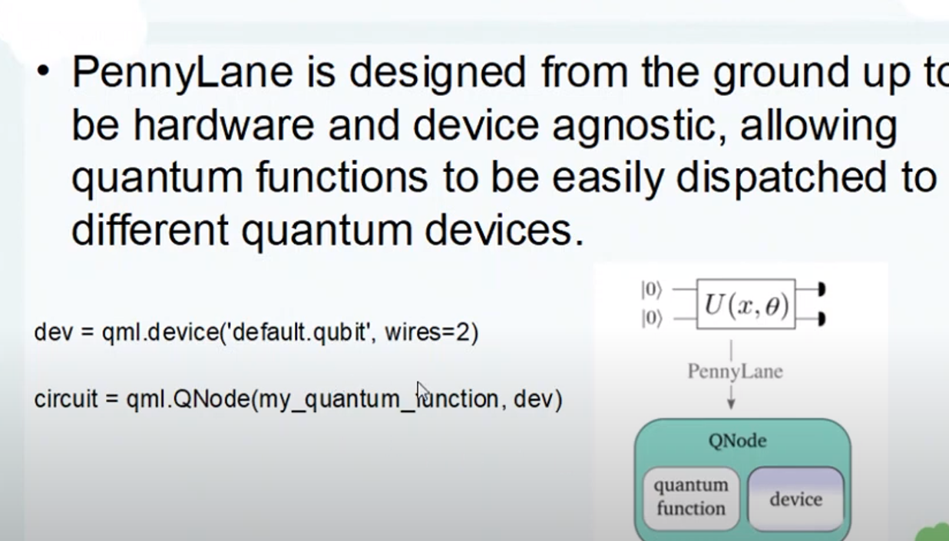
Why PennyLane

Slide 5
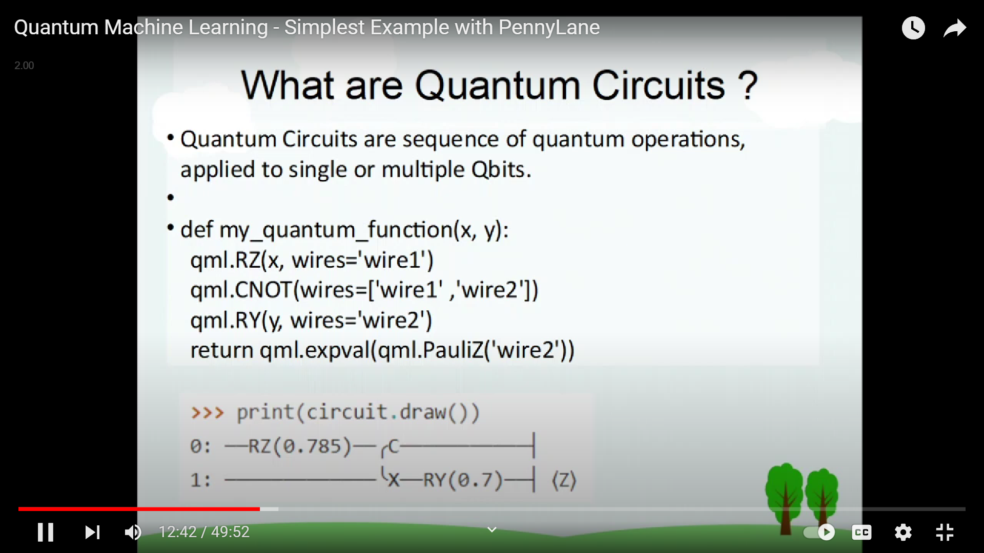
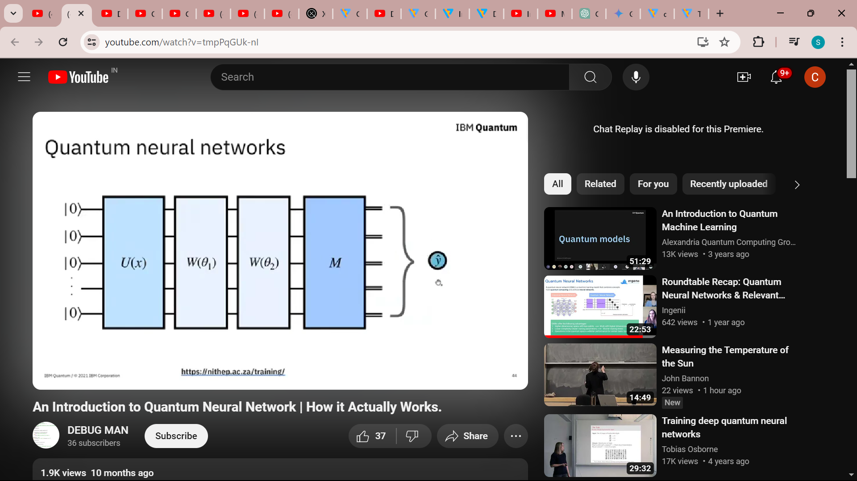
Quantum Neural Network

Slide 6
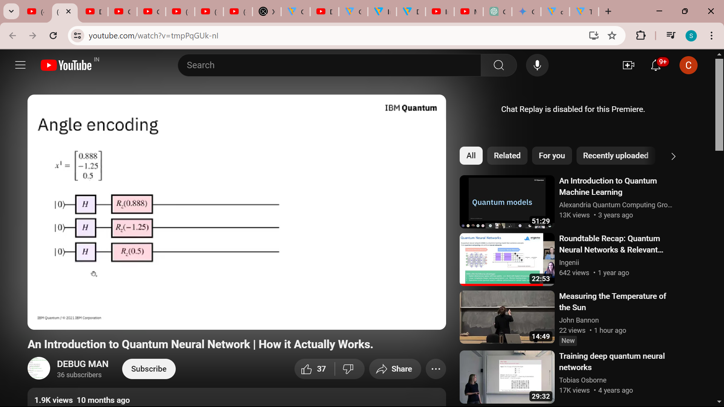
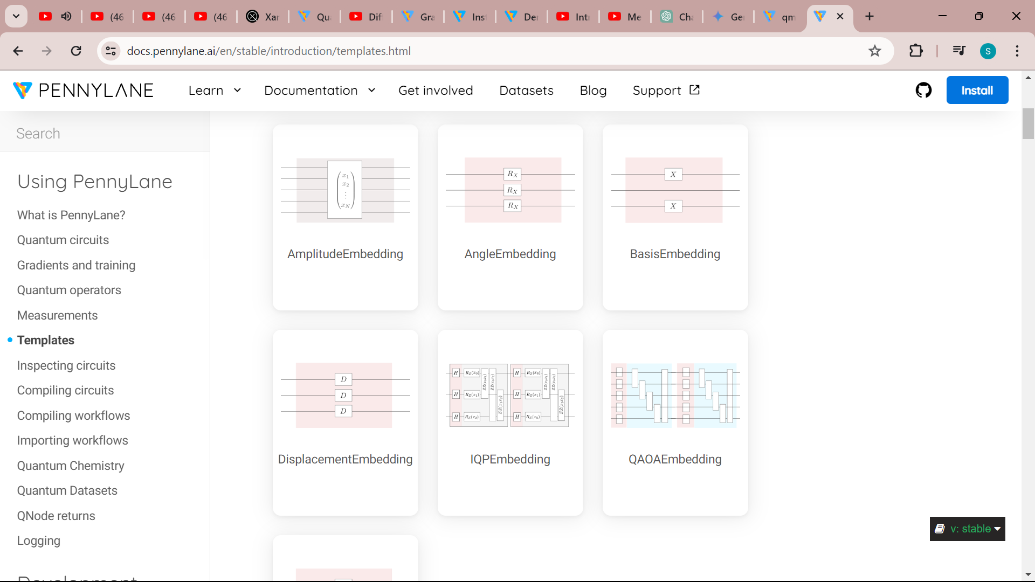
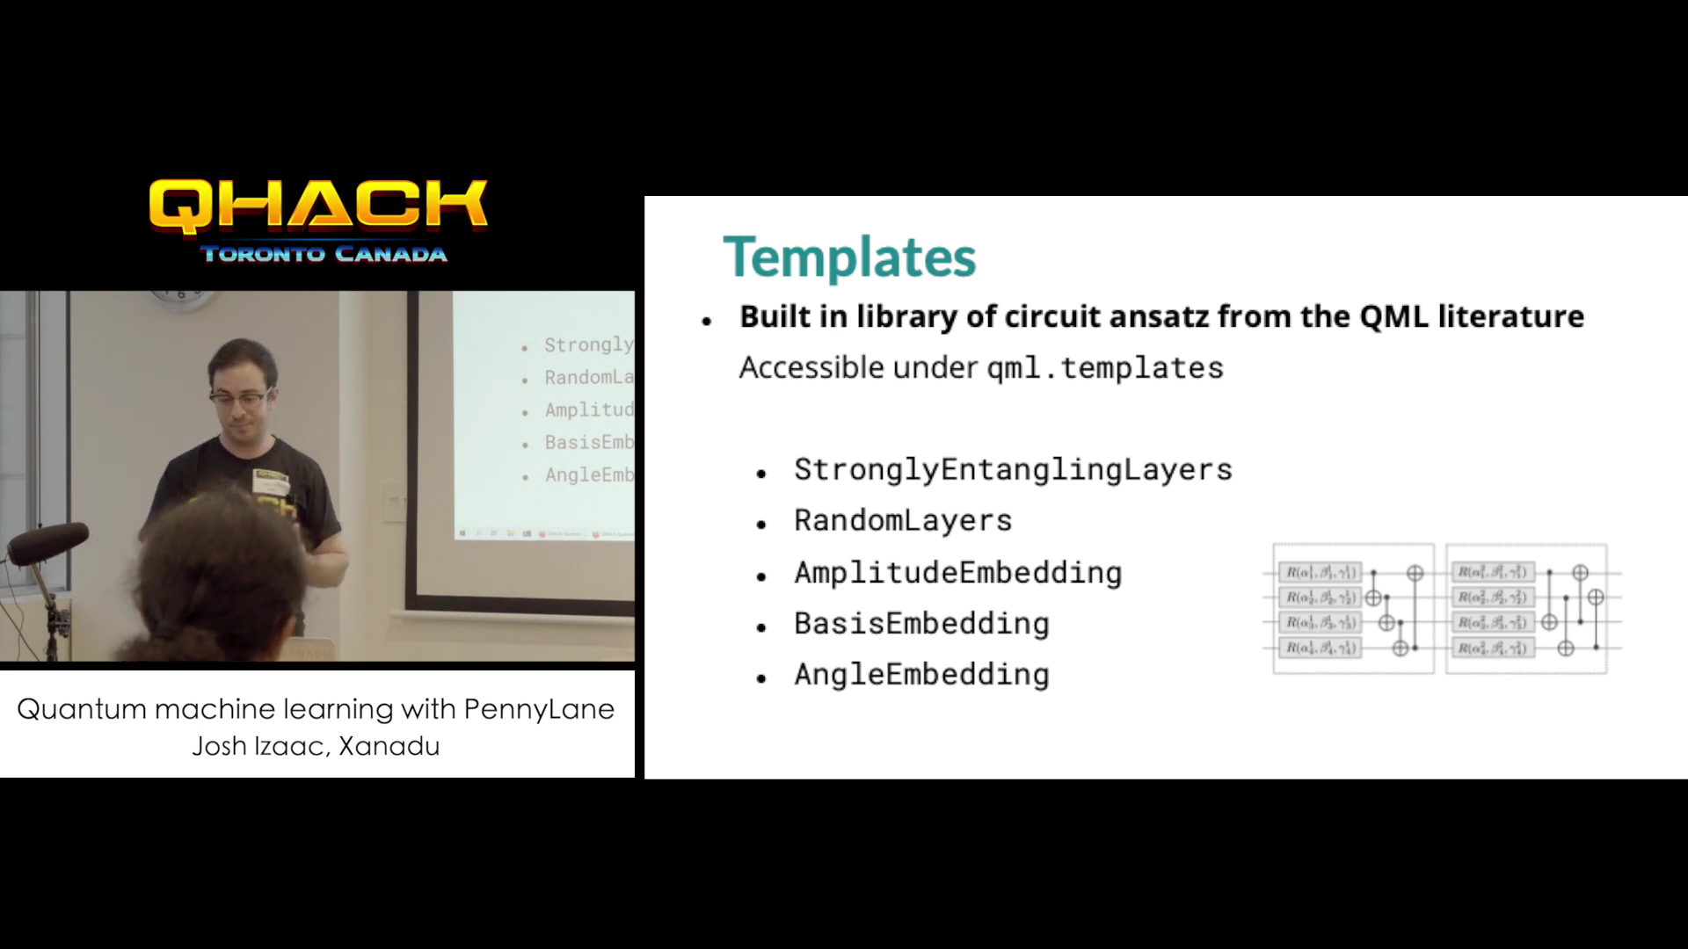
Types of Encoding

Slide 7
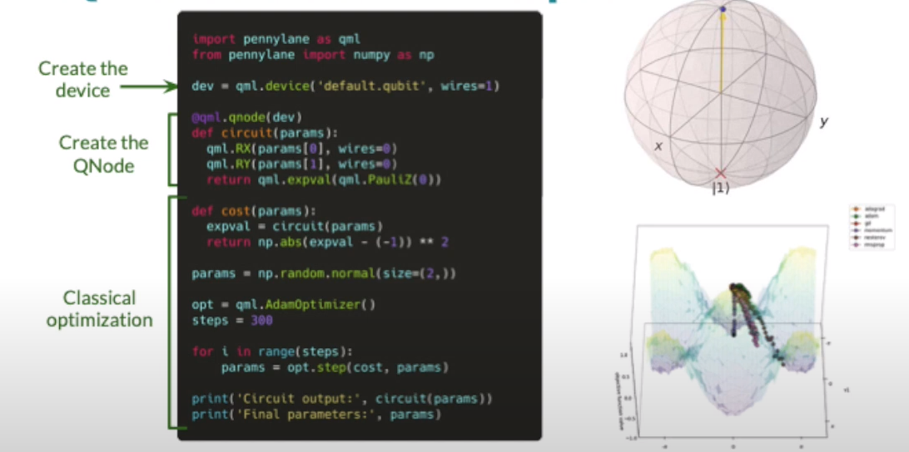
Qubit Rotation Example

Slide 8
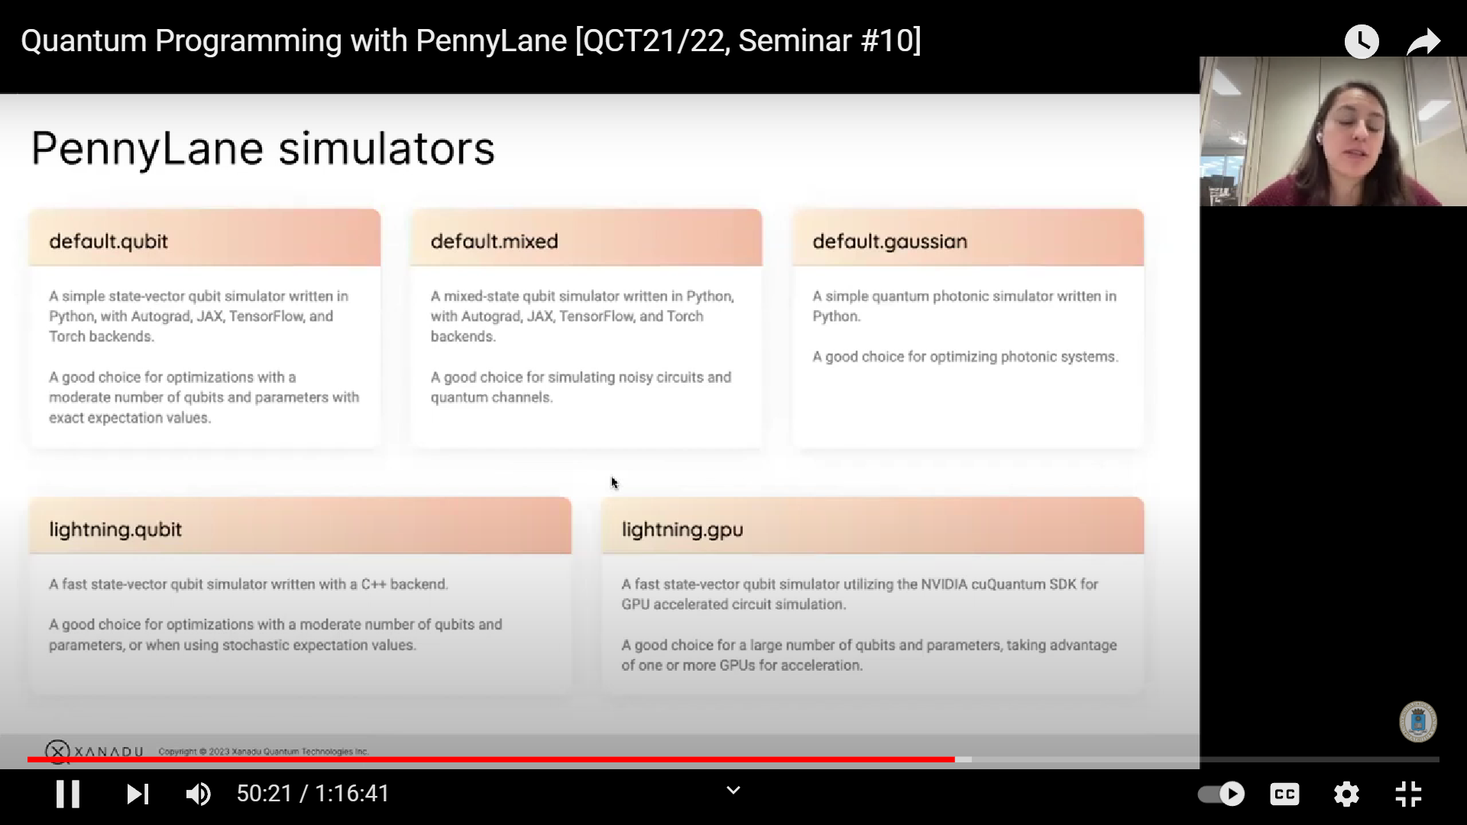
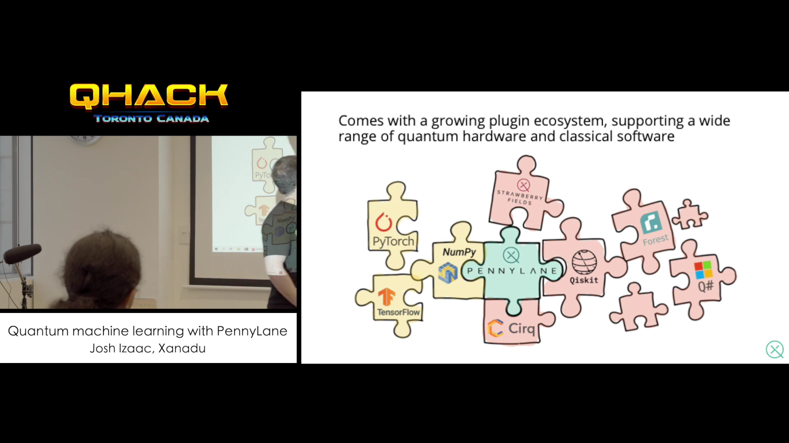
Simulator and Hardware Plugins

Slide 9
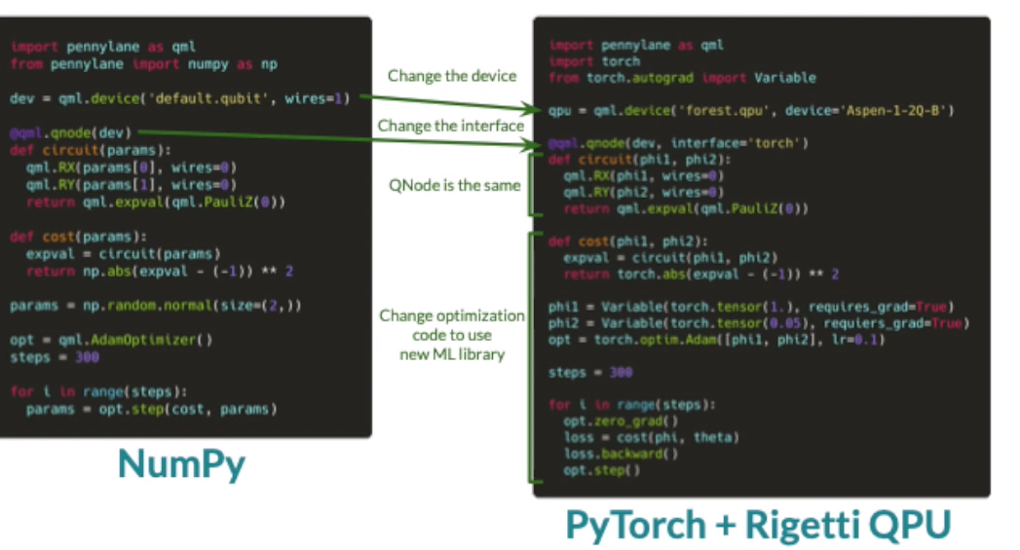
Device and Interface

Slide 10
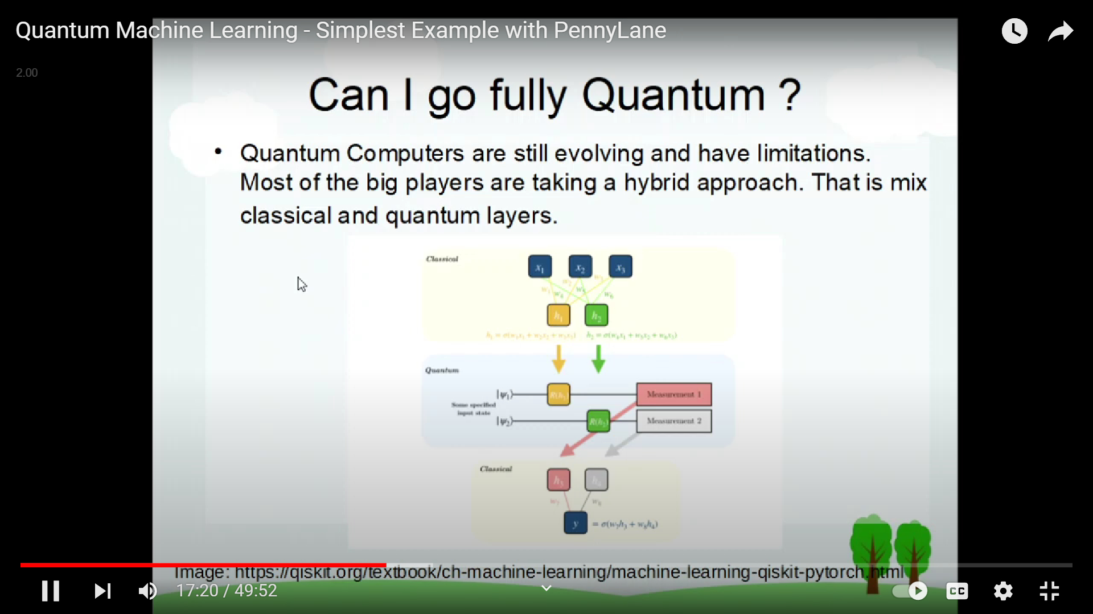
Hybrid Model
Quantum convolution layer
Classical neural network
A QCNN consists of two parts: a quantum convolution layer and a classical neural network. The quantum convolution layer is used to extract features from the input image. The classical neural network is then used to classify the image based on the features extracted by the quantum convolution layer.

Slide 11
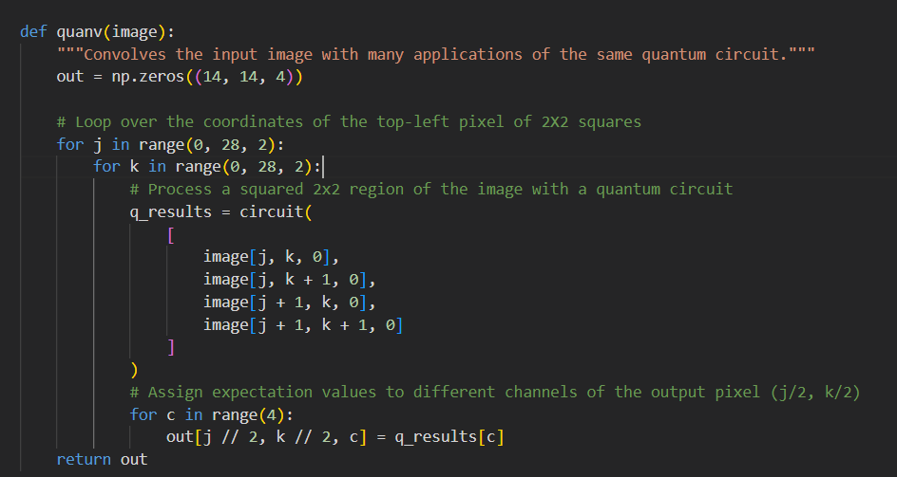
Convolutional Scheme
Image divided into squares
Each square processed by quantum circuit
Expectation values mapped to channels
The image is divided into squares of pixels. The quantum circuit processes each square. The expectation values from the quantum circuit are then mapped to different channels of a single output pixel. This process is repeated for all squares in the image, resulting in a new image that contains the features extracted by the quantum circuit.

Slide 12
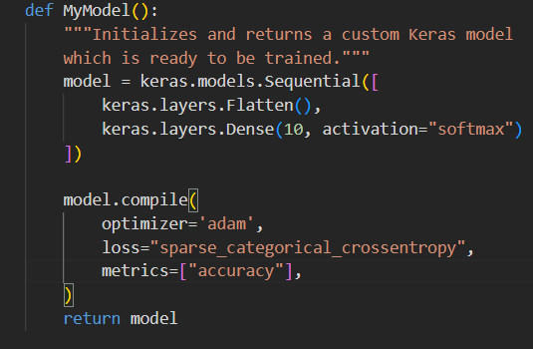
Model
This defines a function MyModel that creates a simple Keras classification model. It flattens the input data (transforms from a 2D image to a 1D vector), adds a dense layer with 10 neurons and softmax activation for 10 class probabilities, and configures the model for training with Adam optimizer, categorical cross-entropy loss, and accuracy metric.

Slide 13
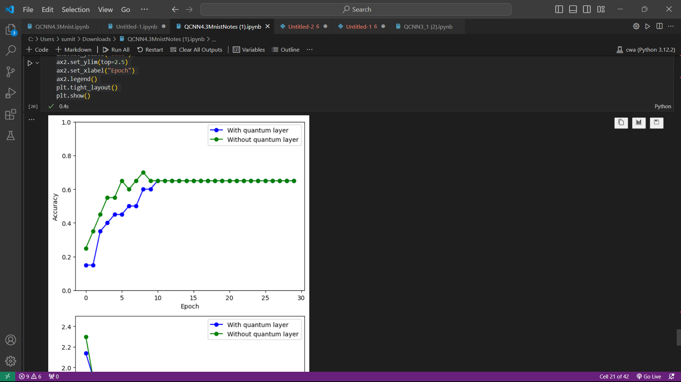
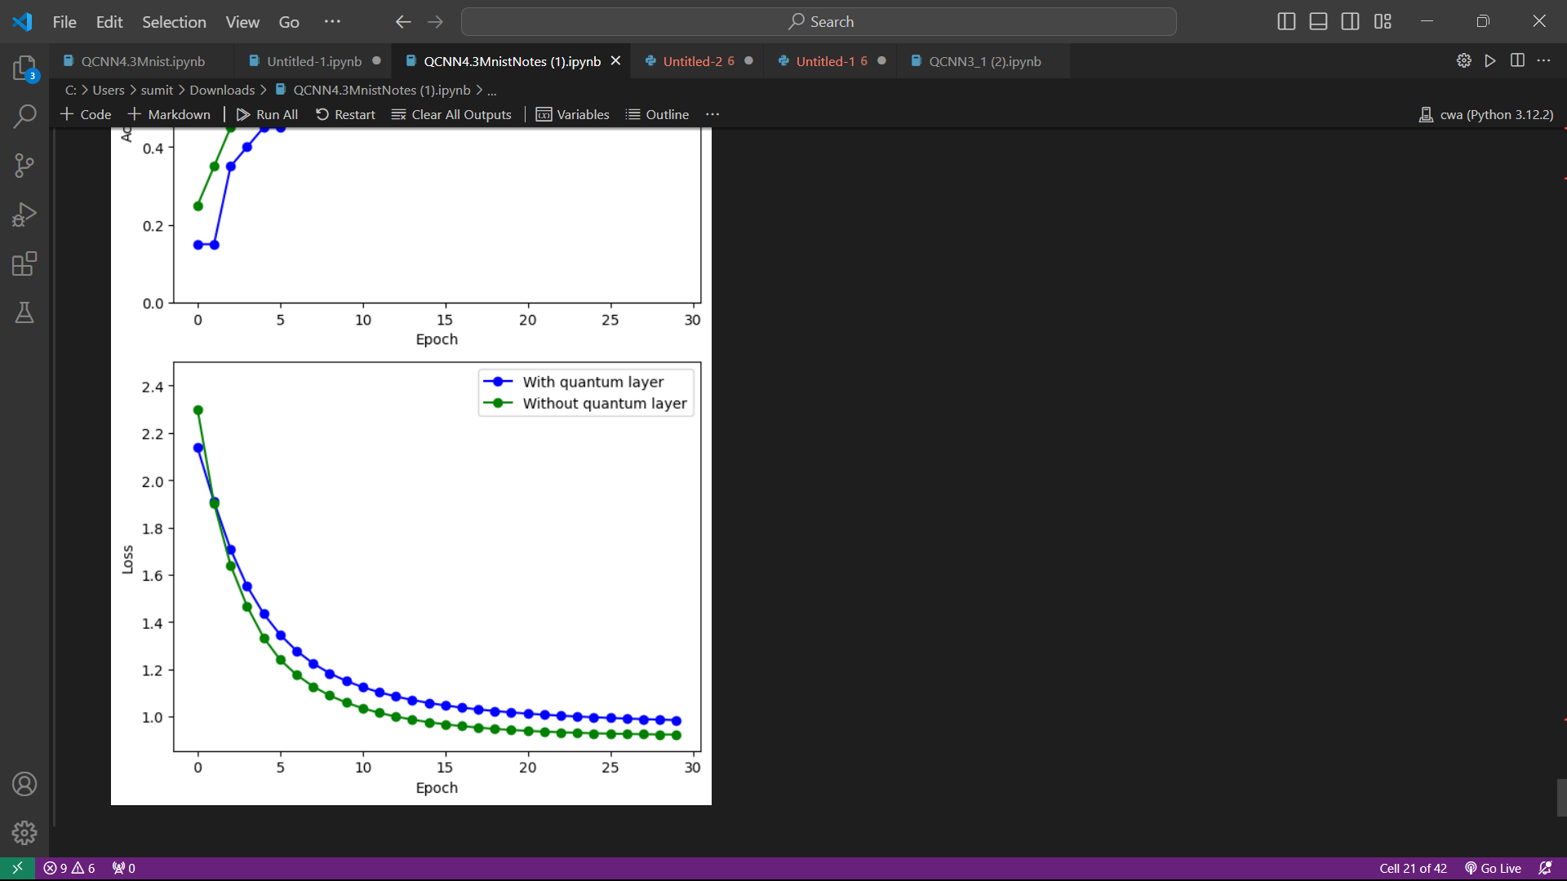
Results – Accuracy and Comparison
We can compare the performance of a QCNN to a classical CNN on the same image classification task. In many cases, QCNNs have been shown to achieve higher validation accuracy than classical CNNs. This suggests that quantum convolution can be an effective way to improve the performance of CNNs.

